Slide 1
Cost Concepts
Module 3 · Video 6
Management 405
Prof. Nico Voigtländer · UCLA Anderson

Slide 2
Module 3 · Agenda
Outline of Module 3
1
Introduction to Module 3
Video 1
2
The Production Function
Video 2
3
Short Run: Hiring Decisions
Video 3
4
Wage Searchers
Video 4
5
Long Run: The Optimal Input Mix
Video 5
6
Cost Concepts
Fixed, variable, marginal, and sunk costs, and which ones matter
Video 6
7
Economies of Scale and Scope
Video 7
Management 405 · Module 3 · Production and Costs
2
Notes:
That wraps up production, the question of what to make and with which inputs. Now we turn to Part 2, costs. The question shifts to what it costs to produce, and just as importantly, which costs should actually drive a decision. That second part trips up a lot of smart people, so we spend real time on it.

Slide 3
Module 3 · Cost Concepts
Three Cost Types
Variable Costs
Fixed Costs
Sunk Costs
Depend on volume produced (Q)
→ Always consider!
Do not depend on quantity produced (Q)
→ Consider for long-run decisions
(entry, exit, capacity)
A fixed cost that
cannot be recovered → Ignore!
Examples
• Buy raw materials
• Hire workers
• Shipping & packaging
Examples
• Rent / lease payments
• Insurance & property tax
• R&D investments (for future innovation)
Examples
• Past R&D
• Past advertising
• Non-refundable deposits
Sunk costs should not affect managerial decisions
Management 405 · Module 3 · Production and Costs
3
Notes:
Let's sort costs into three buckets. First, variable costs. These rise and fall with how much you produce, things like raw materials, the workers you hire, and shipping. Because they change with output, you always weigh them in a decision. Second, fixed costs. These do not change with output, things like rent, insurance, and past R and D. They matter mainly for the big long-run choices, whether to enter, exit, or change capacity. Third, and the one to watch, sunk costs. A sunk cost is a fixed cost you have already spent and cannot get back. We give sunk costs their own slides next, because they are the ones people most often mishandle.

Slide 4
Module 3 · Cost Concepts
Your Car or the Company Car?
For a business trip, you can use:
Your own car
→ you are reimbursed 50¢ / mile
Company car
(full cost incl. charge paid by your company)
Costs associated with your car (per mile driven):
20¢ insurance
20¢ maintenance
15¢ electricity
45¢ lease on the vehicle
⇒ Should you use your own car or the company car?
Poll Break
Management 405 · Module 3 · Production and Costs
4
Notes:
Here is a group exercise to test the sunk-cost idea. For a business trip you can drive your own car and get reimbursed 50 cents a mile, or take the company car, where your company covers the full cost. Look at what your own car costs you per mile. Insurance is 20 cents, maintenance 20 cents, electricity 15 cents, and the lease works out to 45 cents. The instinct is to add all of that up and compare. But here is the trap. The lease is a sunk cost. You are paying it whether or not you take this trip, so it should not enter the decision at all. The only costs that belong in the comparison are the ones that actually change when you drive, the insurance, maintenance, and electricity. Take a moment in your groups to decide which car you should use, keeping the lease out of it, and we will work through it together.

Slide 5

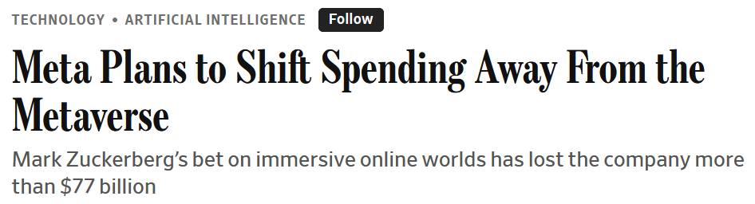
Module 3 · Cost Concepts
Sunk Cost: Meta's Reality Labs Has Lost $70B+
Meta poured ~$70B into Reality Labs since 2020
Quest headsets, Horizon Worlds – thin adoption, little revenue
Hardware/software still not commercially viable – payoff keeps slipping
Wall Street kept asking when it pays off
In 2026: Decision to shift spending to AI
→ Classic sunk-cost discipline
Management 405 · Module 3 · Production and Costs
5
Notes:
The same logic is playing out right now at Meta. Since 2020 Meta has poured somewhere around 70 billion dollars into Reality Labs, its virtual and augmented reality division, and the Wall Street Journal puts the figure north of 77 billion. The Quest headsets and the Horizon Worlds platform never reached mass adoption, revenue stayed thin, and the payoff kept getting pushed further out. Wall Street kept asking when it would pay off. In 2026 Meta made the call to shift a big chunk of that spending over to AI. That is exactly the sunk-cost discipline from Waterworld, in a modern setting. The tens of billions already spent are gone. The only question that matters is where the next dollar earns the most going forward.

Slide 6
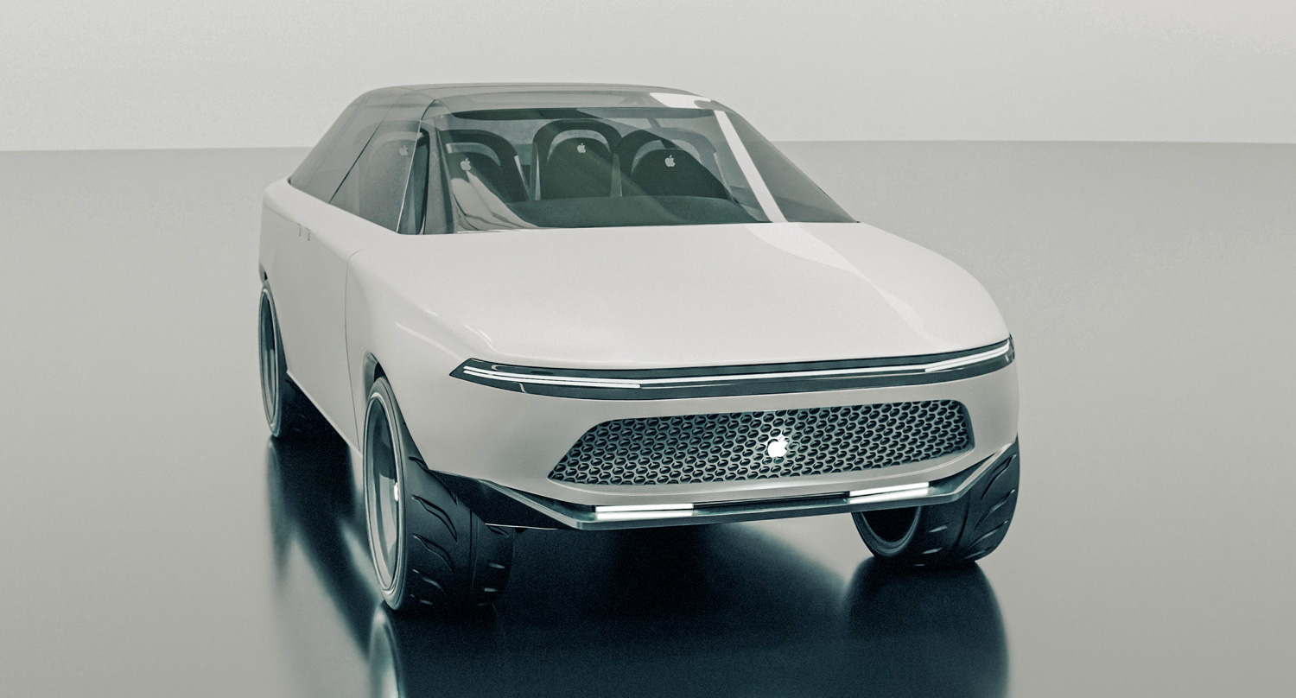
Module 3 · Cost Concepts
Sunk Cost & Opportunity Cost: Apple's Canceled Apple Car
Apple killed Project Titan in 2024 after ~10 years and ~$10B spent
Sunk costs not a reason to keep going
Real reason to stop: opportunity cost of capital + 2,000 engineers
Reallocated → AI / Apple Intelligence (with higher expected returns)
Vanarama Apple Car concept (fair use, © Vanarama)
Opportunity cost = the next-best alternative use for the same dollars & engineers
Management 405 · Module 3 · Production and Costs
6
Notes:
Apple gives us the same lesson with a twist. In 2024 Apple canceled Project Titan, its electric car effort, after about a decade of work and roughly 10 billion dollars spent. Now, that 10 billion is a sunk cost, so by itself it is not a reason to keep going, and it is not a reason to quit either. It is simply gone. The real reason to stop was opportunity cost. The capital, and especially the 2,000 or so engineers on the project, had a more valuable use elsewhere, in Apple's AI work and Apple Intelligence. So Apple reallocated them to the higher-return opportunity. That is the key idea on this slide. Opportunity cost is the value of the next-best use of the same dollars and people. Cutting the car was not about refusing to waste the 10 billion. It was about putting scarce engineers where they create the most value now.

Slide 7
Module 3 · Cost Concepts
Accounting for Opportunity Costs
Rivian needs to expand production capacity
Either build new factory for $6 billion
Or expand/upgrade outdated existing plant for $5 billion
Both options yield identical final plants
 | New Factory | Expand Capacity of Existing Factory
 |  | Existing factory cannot be used otherwise | Existing factory can be sold for $2B
Construction Costs | $6B | $5B | $5B
Fixed Costs (opportunity costs) | 0 | 0 | $2B
Total | $6B | $5B | $7B
Sunk
Resell opportunity
→ Expansion is best option
→ Build new is best option
Management 405 · Module 3 · Production and Costs
7
Notes:
Rivian needs more production capacity and has 2 ways to get it. Build a new factory for 6 billion dollars, or expand and upgrade the outdated plant it already owns for 5 billion. The finished plant is the same either way, so on construction cost alone the expansion looks cheaper by a billion. Now look at the row labelled fixed costs, or opportunity costs. If the old plant has no other use, keeping it costs Rivian nothing. That plant is sunk, the expansion totals 5 billion against 6, and expanding wins. But change one fact. Suppose a buyer would pay 2 billion for that plant. Expanding it now means giving up those 2 billion, and that forgone sale is a cost of the expansion even though no money leaves the company. The expansion really costs 5 plus 2, which is 7 billion, against 6 billion for the new factory. The ranking flips. Same 2 options, same construction bills, opposite answer, and the only thing that changed is whether the asset you already own has a market.

Slide 8



Module 3 · Cost Concepts
Dictionary of Costs
Cheat sheet to refer back to
Total Cost
Average Cost
Marginal Cost
$$TC = TFC + TVC$$
$$ATC = \frac{TC}{Q}$$
$$MC = \frac{ΔTC}{ΔQ}$$
TFC = Total Fixed Cost
(ignore sunk costs)
TVC = Total Variable Cost
AFC = TFC / Q
AVC = TVC / Q
ATC = AFC + AVC
= ΔTVC / ΔQ (TFC is constant)
Derivative form:
MC = dTC / dQ
= dTVC / dQ
Management 405 · Module 3 · Production and Costs
8
Notes:
Here is a cheat sheet you will come back to for the rest of the module, so let me walk the three groups quickly. Total cost splits into total fixed cost and total variable cost, and remember, fixed cost here excludes anything sunk. Then the averages, which are just those totals spread over the number of units. Average fixed cost is fixed cost divided by quantity, average variable cost is variable cost divided by quantity, and average total cost is the two added together. Finally, the one we use most for decisions, marginal cost. That is the change in cost from producing one more unit. Since fixed cost does not change, marginal cost comes entirely from the variable side. Keep this slide handy, because these six terms show up everywhere from here on.

Slide 9
Module 3 · Cost Concepts
Rivian's Georgia Plant — Weekly Cost
Collect data on total cost at different output levels (Q) → Estimate the cost function
$$Estimated cost curve: TC = 10,000,000 + 30,000 · Q + 40 · Q^{2}$$
Fixed Cost
Quadratic term: cost rises faster than output, i.e. marginal cost is increasing
Management 405 · Module 3 · Production and Costs
9
Notes:
Now let's build a cost function from data, back at Rivian's Georgia plant. The dots are actual weekly cost observations at different output levels. The smooth navy curve is the cost function we fit through them. Read it in three pieces. Where the curve meets the vertical axis, that is fixed cost, the roughly 10 million dollars a week Rivian pays even at zero output. Then there is a straight-line part, a constant cost of about 30,000 dollars for each vehicle. And finally a gently curving part, a quadratic term, that makes total cost rise faster than output as the plant gets busy. That upward bend matters. It means marginal cost is increasing, so each additional car costs a little more than the last as the plant approaches its limits.

Slide 10
Module 3 · Cost Concepts
Rivian's Georgia Plant — Cost Components
Fixed costs dominate at low Q; the quadratic TVC overtakes at scale
Management 405 · Module 3 · Production and Costs
10
Notes:
Here is that same cost curve split into its two parts, so you can see where the money goes. The flat line at the bottom is total fixed cost, the 10 million dollars a week that does not change with output. Everything above it is total variable cost, which grows with production and includes that rising quadratic piece. Add the two together and you get the total cost curve. Watch how the balance shifts as output grows. At low volumes the fixed cost dominates, it is most of what you are paying. But as output climbs, the variable cost takes over and becomes the larger share. That shift is why the same plant can feel fixed-cost-heavy when it is quiet and variable-cost-heavy when it is running flat out.

Slide 11
Module 3 · Cost Concepts
Rivian's Georgia Plant — Per-Unit Costs
ATC falls below sales price ($80k) at Q ≈ 250
The minimum of ATC is where it crosses MC
ATC increases again due to rising MC
Management 405 · Module 3 · Production and Costs
11
Notes:
Now the same cost function expressed per vehicle, which is how managers usually think about it. The U-shaped curve is average total cost, the cost per car. It falls at first as the big fixed cost gets spread over more vehicles, reaches a minimum, and then rises again as the increasing marginal cost takes over. There are three things to read off it. First, average total cost drops below the roughly 80,000 dollar sales price at an output of about 250 cars a week, so that is where the plant starts making money on average. Second, the minimum of average total cost sits exactly where the marginal cost curve crosses it, which is always the case and worth remembering. Third, past that point average cost turns back up, pushed by the rising marginal cost. So there is a sweet-spot output where the cost per car is lowest.

Slide 12
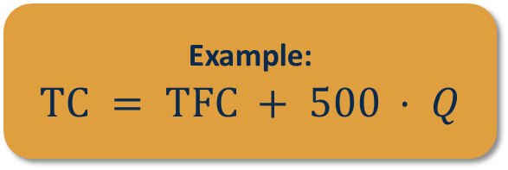
Module 3 · Cost Concepts
In practice, we will often usually use a naïve linear cost function
$ (Total cost)
Example:
$$TC = TFC + 500 · Q$$
slope = $500
TFC
Q (quantity produced)
Linear TC : fixed cost + constant marginal cost ($500 / unit)
Management 405 · Module 3 · Production and Costs
12
Notes:
For most of the decisions in this course, we will use a simpler, cleaner version of a cost function, the naive linear one. Total cost is just a fixed cost plus a constant marginal cost per unit. On the chart, the line starts up the vertical axis at the fixed cost, and then rises at a steady slope. That slope is the marginal cost, here 500 dollars per unit, and it is the same for every additional unit. It is the simplest possible cost model, a flat fee plus a constant per-unit cost, and it is good enough for most of what we do. We will bring back the more complex curved shapes only when scale really changes the story.

Slide 13
Module 3 · Cost Concepts
Naïve Linear Cost Function: Per-Unit Costs
$ per unit
ATC
Note:
When MC is constant,
it equals AVC
500
MC = AVC = $500
Q (quantity produced)
Per-unit cost: constant marginal cost, ATC falls as fixed cost spreads
Management 405 · Module 3 · Production and Costs
13
Notes:
Here is that same simple cost function seen per unit. Because marginal cost is constant at 500 dollars, the marginal cost line is flat. And when marginal cost is constant, it equals average variable cost, so those two lie right on top of each other at 500. The interesting curve is average total cost, the one sloping downward. It starts high, because at low output the fixed cost is spread over just a few units, and it falls steadily toward 500 as output grows and the fixed cost gets diluted across more and more units. So the takeaway is simple. With constant marginal cost, producing more does not lower the cost of the next unit, but it does keep lowering the average, because the fixed cost is shared more widely.

Slide 14
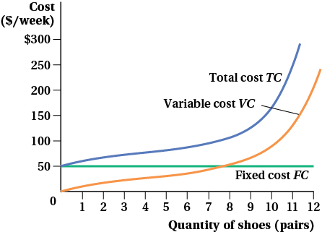
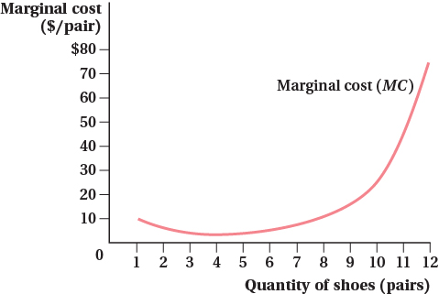
Module 3 · Cost Concepts
More Complex Cost Functions: When MC Isn't Linear
Total / variable / fixed cost — convex at high Q
Marginal cost — U-shape (high at low + high Q)
Keep MC linear when possible — use the U-shape only when scale really matters
Management 405 · Module 3 · Production and Costs
14
Notes:
A quick reality check before we move on. Real cost functions are not always a straight line. The classic textbook shape is a U for marginal cost. On the left you can see total, variable, and fixed cost, with the total curve bending upward at high output. On the right is the marginal cost itself, and it is U-shaped. It starts high when the plant is barely used, falls to a low point at the plant's sweet spot, and then rises again when you push past capacity into overtime and congestion. We saw the rising part in Rivian's quadratic cost. For most decisions in this course we will still use the simpler linear marginal cost, and only reach for the U-shape when scale genuinely drives the answer.

